Slide 1
Case Study: Regression
Machine Learning

Slide 2
Course Outline
Assignments are submitted at the same date as the next assignment comes out
Wk | Lecture 1 | Lecture 2 | Individual Assignment | Project Assignment
1 | Case Study: Regression | Case Study: Classification | A1: Car Price Prediction
2 | Batch Gradient Descent | Stochastic / Mini-Batch Gradient Descent
3 | Regularization | Binary Logistic Regression | A2: Car Price Prediction II
4 | Multinomial Logistic Regression | Gaussian Naive Bayes
5 | Multinomial Naive Bayes | K-Nearest Neighbors / Support Vector Machine | A3: Car Price Prediction III
6 | Decision Tree | Bagging / Random Forests / Ada Boosting / Gradient Boosting
7 | No class | Midterm Exam |  | Phase 1: Reading paper round 1 (KDD)
8 | K-Means Clustering | Gaussian Mixture |  | Phase 1: Reading paper round 2 (KDD)
9 | Principal Component Analysis | PyTorch Linear Regression |  | Phase 2: Proposal - Paper writing (Intro, Related Work, Method)
10 | PyTorch Logistic Regression | Project Proposal Presentation
11 | Convolutional Neural Network | Recurrent Neural Network |  | Phase 3: Experiment - Paper writing (Intro, Related Work, Method, Results)
12 | Reinforcement Learning | Project Time
13 | Project Time | Project Progress Presentation
14 | Project Time | Project Time |  | Phase 4: Conclusion - Paper writing (Abstract, Intro, Related Work, Method, Results, Discussion, Conclusion)
15 | No class | Final Exam
16 | No class | Final Project Presentation

Slide 3
Background - Regression
Predict blood pressure level using BMI?
Predict GDP using egg price, gold price, oil price?
Predict life expectancy using population, GDP?
We called population, GDP as features (a.k.a predictors, independent variables ), and life expectancy as labels (a.k.a targets, dependent variables )
Notice all the labels here are continuous values?
Regression is a supervised algorithm to predict continuous values
Labels must be continuous; features can be categorical or continuous
Both features and labels can be univariate or multivariate
Supervised - has both features and labels; Unsupervised - only has features
Continuous - opposite of categorical variables, e.g., gold price is continuous while gender is categorical
Continuous value can be change to categorical variables by binning!

Slide 4
Big picture of ML
Remember: Splitting > Imputation > Scaling
Step 2 to 5 - can be done iteratively and order may swap, it’s ok
1. Load data -> 2. Exploratory Data Analysis -> 3. Feature engineering -> 4. Feature selection -> 5. Preprocessing
CSV, JSON, Database
Renaming
Label encoding
Train / dev / test set
Check class imbalance
Countplot
Distribution plot
Boxplot
Scatter plot
Correlation Matrix
Predictive Power Score
Dimensionality reduction
Feature splitting (e.g., date)
Creating features (e.g., some equation)
Select your X (features) and y (target)
In ML, it’s better to choose X
In DL, we usually just input all features
Null values
Outliers
Fix class imbalance (up-/down-sampling
Typos / Entry errors / Duplicates / IDs
Scaling (min-max; standardize)
6. Model selection -> 7. Testing -> 8. Analysis -> 9. Inference -> 10. Deployment
Supervised
Regression
Classification
Unsupervised
Clustering
Dimensionality reduction
Reinforcement
PPO
Q-learning
Apply your best model on your test set
Analyze your model, e.g., feature importance
Apply your best model on some unseen data, and see whether it makes sense
HTML/CSS/JS
TOOLS
Python, R - programming tool
NumPy (matrix manipulation), Pandas (Excel-like), Matplotlib/Seaborn (visualization), Sklearn (machine learning), PyTorch (deep learning), Huggingface (models)
Tableau, Power BI - Business Intelligence (BI) tools
Microsoft Azure, Rapidminer, Weka - data science and machine learning tools
SPSS, SAS, JASP - statistical tool
Flask
Django
FastAPI
Docker
METRIC
Regression (r², MSE)
Classification (recall, precision, f1)
Clustering (inertia)
Dimensionality reduction (mean squared distance between the original data and the reconstructed data)
Reinforcement learning (cumulative rewards)
Overfitting
Underfitting
MLFlow
Wandb
Tensorboard
TOP VENUES
ML (KDD)
DL (ICML, NIPS, ICMR)
NLP (ACL, EMNLP)
CV (CVPR, ICCV)
Cross-validation
With/Without Sampling
Grid search

Slide 5
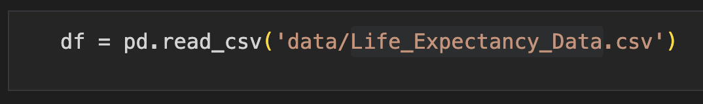
Load data
Getting data
www.kaggle.com/datasets
API, e.g., Instagram API, Twitter API, Weather API, Stock Price API
Google Dataset search
Collect data using sensors
Data format: CSV, JSON, Databases (SQL)
Figure: Python can easily read your csv file

Slide 6
2. Exploratory Data Analysis
Perhaps the most important step - understand your data
Label encoding: encode so we can visualize properly, as well as performing correlation etc.
categorical variables into integers, e.g., male => 0; female => 1
Univariate
Countplot
Distribution plot
Multivariate
Boxplot
Scatter plot
Correlation Matrix
Predictive Power Score

Slide 7
One-hot encoding
Recall label encoding which we turn categories into 0, 1, 2 etc.
When we have more than two categories, if we encode into 0, 1, 2
we create a unintentional order, i.e., the model "may" think that 0 < 1 < 2
Possible solution: one hot encoding
E.g., Male, Female, Unknown ⇒ [1, 0, 0] if male; [0, 1, 0] if female
Limitation
what if we have like 5000 categories....
one hot encode this will result in 5000 columns --> too much! -> Two choices:
Group these categories into bigger categories, and then one-hot encode
Do label encoding anyway......but note the possible order effect
Tips: one thing you need to know is that you can always cut down one column
[1, 0, 0], [0, 1, 0], [0, 0, 1] is same as [1, 0], [0, 1], [0, 0] by setting ‘drop_first=True’

Slide 8
3. Feature engineering
Dimensionality reduction - reduce dimensions, e.g, Principal Component Analysis (maximizes variances), Discriminant Analysis (maximizes separability)
Feature splitting - Jan 26, 2023 ===> Monday or January
Creating features (e.g., some equation) - combining the total sales from each sale department
Note: After such engineering, you can always go back to exploratory analysis

Slide 9
4. Feature selection
Choose the most salient X
Rule of thumb: Good features MUST NOT BE correlated, i.e., independent
Rule of thumb: Correlation is not causation; don’t pick features using correlation only; it should make sense!
E.g., Number of trees is correlated with number of divorce
Rule of thumb: For ML, less features are usually better (but NOT necessarily for DL)
Specify the y
Split train / test
Rule of thumb: Always split BEFORE preprocessing, to prevent data leakage
Can be done in this order: (1) splitting, (2) imputation, (3) scaling

Slide 10
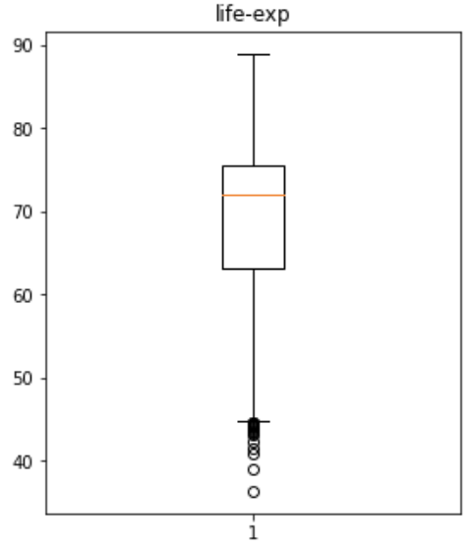
5. Preprocessing
Numbers: 4, 5, 6, 8, 8, 9, 10, 11, 13, 18
50% = (8 + 9) / 2 = 8.5
75% = 10, 11, 13, 18 = (11 + 13) /2 = 12
25% = 4, 5, 6, 8 = (5 + 6) / 2 = 5.5
IQR = Q3 - Q1 = 12 - 5.5 = 6.5
Min = Q1 - 1.5 (IQR) = 5.5 - 1.5 (6.5) = -4.25
Max = Q3 + 1.5(IQR) = 12 + 1.5 (6.5) = 21.25
“Max” (Q3 + 1.5 IQR)
75% (Q3)
50%
IQR (Q3-Q1)
Imputing missing values
For missing “numbers”,
Replace with average | median | regression results | 0
For missing “categories”
Replace with mode | ratio | “No category”
1st rule of thumb: replacing should not drastically change the distribution
2nd rule of thumb: don’t delete if you are not sure what you are dealing with
3rd rule of thumb: replace ONLY features, NOT labels. Don’t create fake labels.
Outliers
Use visualization such as box plot or z-score
Rule of thumb: Don’t just delete using box plot rule. Use your common sense to understand what is possible, errors, and impossible
Typos / Entry errors / Duplicates / IDs
25% (Q1)
“Min” (Q1 - 1.5 IQR)
Outliers

Slide 11
5. Preprocessing - scaling
Scale your features
Help the model to learn faster
Standardization
(x - mean) / std
when your data follows normal distribution
Normalization
(x - x_min) / (x_max - x_min)
when your data DOES NOT follow normal distribution (e.g., audio, signal, image)
Rule of thumb: Scale after you split and fill all the missing values
Rule of thumb: Scale your test set using training distribution, NOT testing distribution
Rule of thumb: DON’T scale your categorical features

Slide 12
6. Model selection - many algorithms
Compare algorithms - so many algorithms
Linear Regression, Random Forest Regressor, etc.
Within these algorithms, many parameters
It’s not ok to use test-set to compare
We use cross-validation!

Slide 13
6. Model selection - cross validation
Cross validation (k = 5)
All Data
Training set
Test set
Iteration 1
Fold 1
Fold 1
Fold 1
Fold 1
Fold 1
Iteration 2
Fold 1
Fold 1
Fold 1
Fold 1
Fold 1
Here we got five scores; we average them to get the total score of one algorithm
Iteration 3
Fold 1
Fold 1
Fold 1
Fold 1
Fold 1
Iteration 4
Fold 1
Fold 1
Fold 1
Fold 1
Fold 1
Iteration 5
Fold 1
Fold 1
Fold 1
Fold 1
Fold 1
Final evaluation
Test set

Slide 14
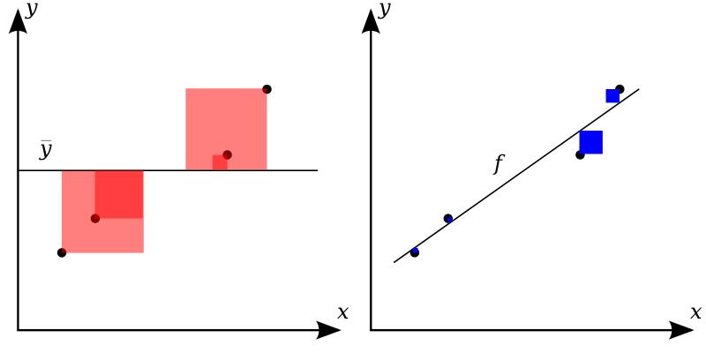
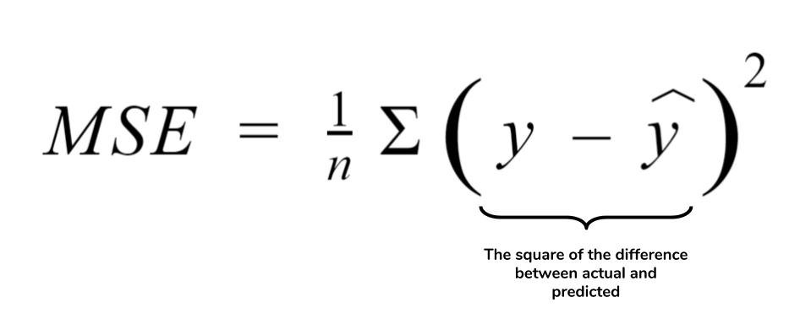


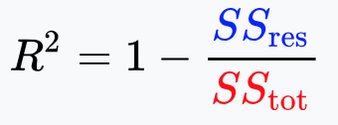
6. Model selection - metrics
Regression
R²(R-squared)
MSE (Mean Squared Error)
RMSE (Root Mean Squared Error)

Slide 15
6. Model selection - grid search
Once we know which algorithm is best, we can further do cross-validation on that only algorithm with different parameters to find the best version
This is called “Grid Search”

Slide 16
7, 8, 9, 10: Test, Analysis, Inference, Deploy
Test - test your model with the test set
Analysis - analyze your model, e.g., feature importance, where error comes from
Inference - test your model with some unseen data and see whether it makes sense
Deploy - deploy to web using Django, Flask, FastAPI, Streamlit, etc.

